Slide 1
Cross-Platform Mobile Applications Development
B.Sc. Web Technologies & Programming
Department of Computer Science & Applied Physics

Slide 2
Lecturer Gerard Harrison
Email Gerard.Harrison@gmit.ie
Office 505
Lectures 3 hours per week
Labs 3 hours per week

Slide 3
Cross-platform Mobile Applications Development
Introduction to module
History of mobile devices
Android
Development Options
Frameworks
Ionic Framework

Slide 4
Cross-platform Mobile Applications Development
Introduction to module
History of mobile devices
Android
Development Options
Frameworks
Ionic Framework

Slide 5
Introduction to Module
Marking Scheme
In-class test (theory) 15% week 4/5
In-class test (practical) 20% week 7/8
Project 65% submit week 13
Reading List
Ionic in Action: Hybrid Mobile Apps with Ionic and AngularJS by Jeremy Wilken
ISBN 9781633430082

Slide 6
Introduction to Module
Websites
http://www.w3schools.com/
http://ionicframework.com/
https://cordova.apache.org/
https://jsbin.com/

Slide 7
Introduction to Module
Learning Outcomes
Create mobile applications using modern architectural patterns.
Compare and contrast mobile development frameworks.
Setup and use a mobile development environment and toolchain.
Manage the development of a mobile application.

Slide 8
Cross-platform Mobile Applications Development
Introduction to module
History of mobile devices
Android
Development Options
Frameworks
Ionic Framework

Slide 9
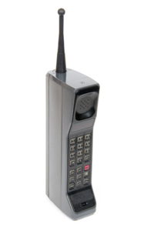

History of Mobile Devices
First mobile phone call
made April 3rd 1973 in
New York
Prototype of a
Motorola DynaTAC 8000x
Mass appeal in 1990s
Nokia’s 1011

Slide 10
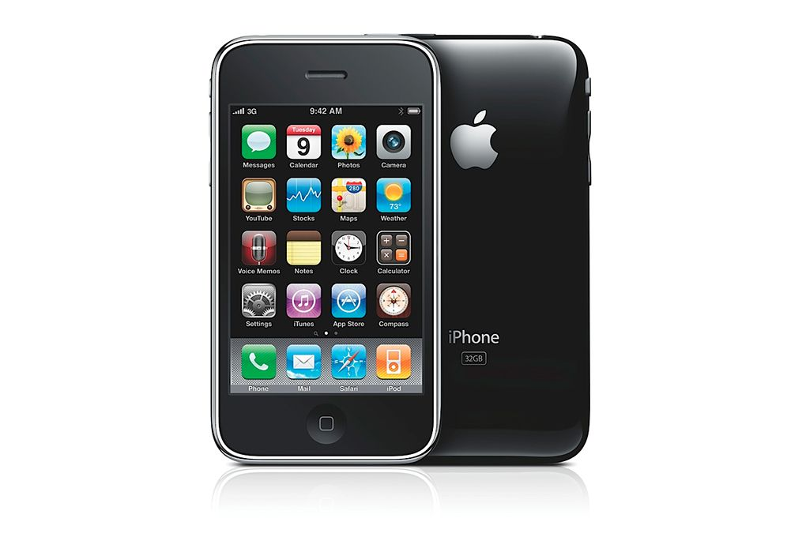
History of Mobile Devices - iOS
2007 Apple introduces
the iPhone
Touch Interface
Web Browser
Mail Client
Widgets (apps)
“Locked” to AT&T in the USA

Slide 11
History of Mobile Devices - Android
2003 - Android Inc. setup by Andy Rubin with the aim of developing “smarter mobile devices that are more aware its owner’s location and preferences”.
2005 - Google buys Android Inc.
2007 - Google sets up Open Handset Alliance and makes Android Operating System free and open source
Why?

Slide 12
History of Mobile Devices – Android
Google is not Android
Android Open Source Project controls Android
Anyone can make his/her own version of Android
Google Android Apps are not open source
Google takes AOSP code and makes it’s own closed source version. (As it is entitled to do)

Slide 13
History of Mobile Devices - Android
Google’s Android version is the most familiar
Other versions
Amazon Fire
No Play Store
No Google Maps etc
Android in China

Slide 14
History of Mobile Devices - Windows
2003 – Windows Mobile released
Based on Windows platform
2010 – Windows Phone replaces Windows Mobile
Other Mobile Platforms:
Blackberry
Firefox OS
Ubuntu Touch OS

Slide 15
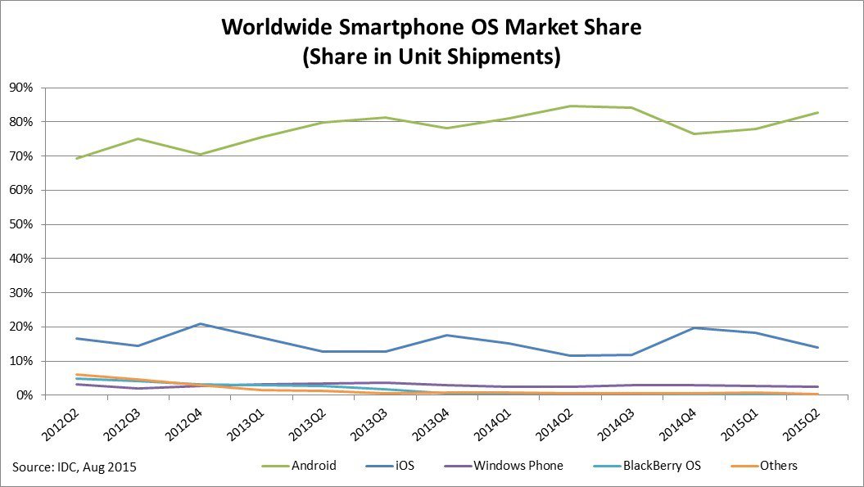
History of Mobile Devices – Market Share

Slide 16
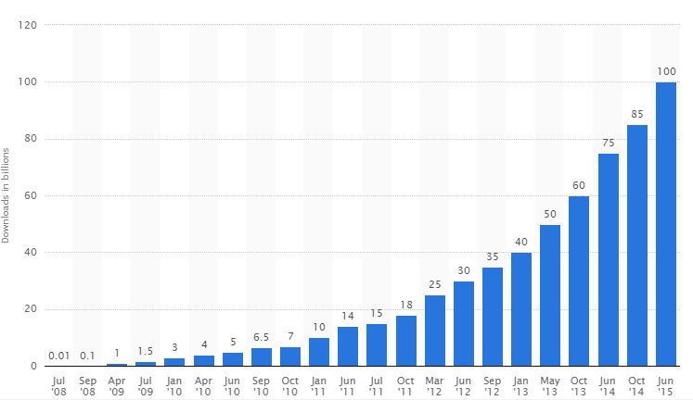
Cumulative App Downloads from App Store

Slide 17
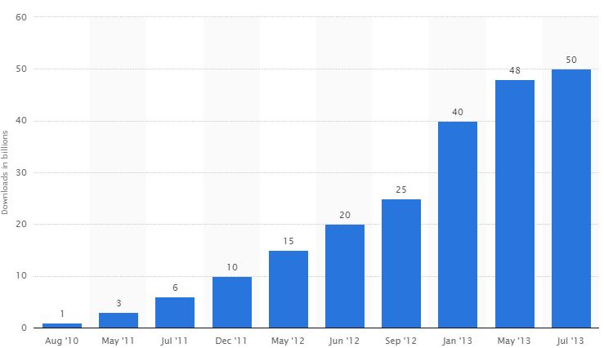
Cumulative App Downloads from Google Play

Slide 18
Cross-platform Mobile Applications Development
Introduction to module
History of mobile devices
Android
Development Options
Frameworks
Ionic Framework

Slide 19
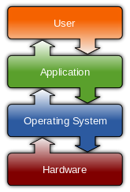
Operating Systems (OS)
The OS manages hardware and
software resources
Provides a stable, consistent way for
applications to deal with the hardware
without knowing the underlying details

Slide 20
Types of Operating System
Windows
iOS
Mac OS
Android
Linux
Unix
Blackberry

Slide 21
Android Architecture
Applications
apps reside on this layer
Android Framework
Provides services to the Applications layer in the form of APIs (Application Program Interface)

Slide 22
Android Architecture
Native Libraries
Libraries such as SQLite database, libraries to play and record media and Secure Socket Layer (SSL) libraries responsible for security
Android Runtime
Java libraries and the Dalvik Virtual Machine

Slide 23
Android Architecture
Hardware Abstraction Layer (HAL)
A hardware abstraction layer (HAL) is a layer of programming that allows a computer operating system to interact with a hardware device at a general or abstract level rather than at a detailed hardware level.
Essentially it allows developers to write device-independent programs and applications.

Slide 24
Android Architecture
Linux Kernel
Has been in widespread use for many years.
Process Management
Memory Management
Security Management
Process Isolation
Prevents one process from reading another processes data
Ensures one process does not consume all the memory
Ensure one process does not consume all CPU time
Ensure one process does consume a resource e.g. bluetooth, GPS

Slide 25
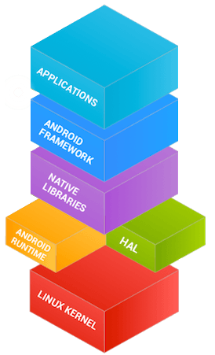
Android Architecture

Slide 26
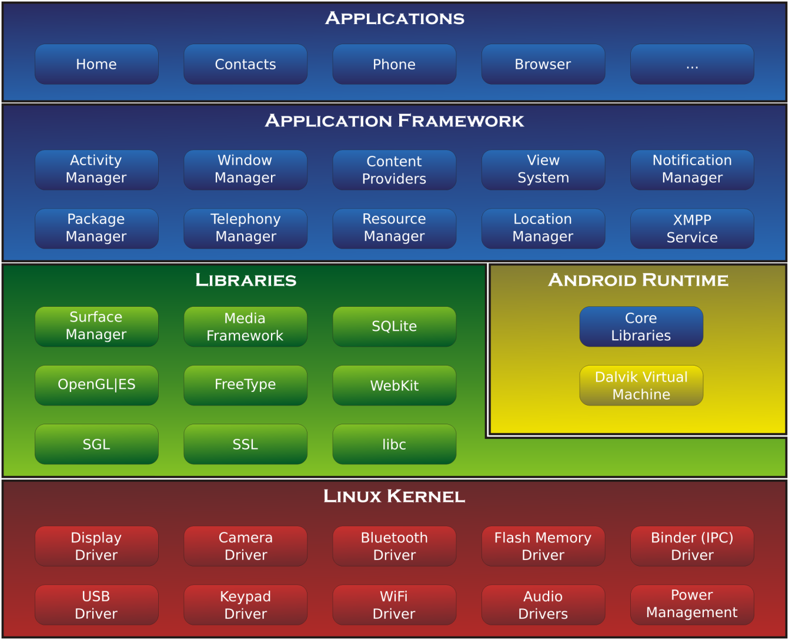
Android Architecture

Slide 27



Android Versions
Cupcake 1.5 (2009)
Donut 1.6 (2009)
Eclair 2.0/2.1 (2009)

Slide 28



Android Versions
Froyo 2.2 (2010)
Gingerbread 2.3 (2010)
Honeycomb 3.0/3.1/3.2 (2011,2012)

Slide 29
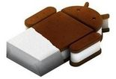


Android Versions
Ice-cream Sandwich 4.0 (2013)
Jellybean 4.1/4.2/4.3 (2013)
KitKat 4.4 (2013)

Slide 30


Android Versions
Lollipop 5.1/5.1 (2014)
Marshmallow 6.0 (2015)

